Slide 1
Hand Detection and Tracking

Slide 2
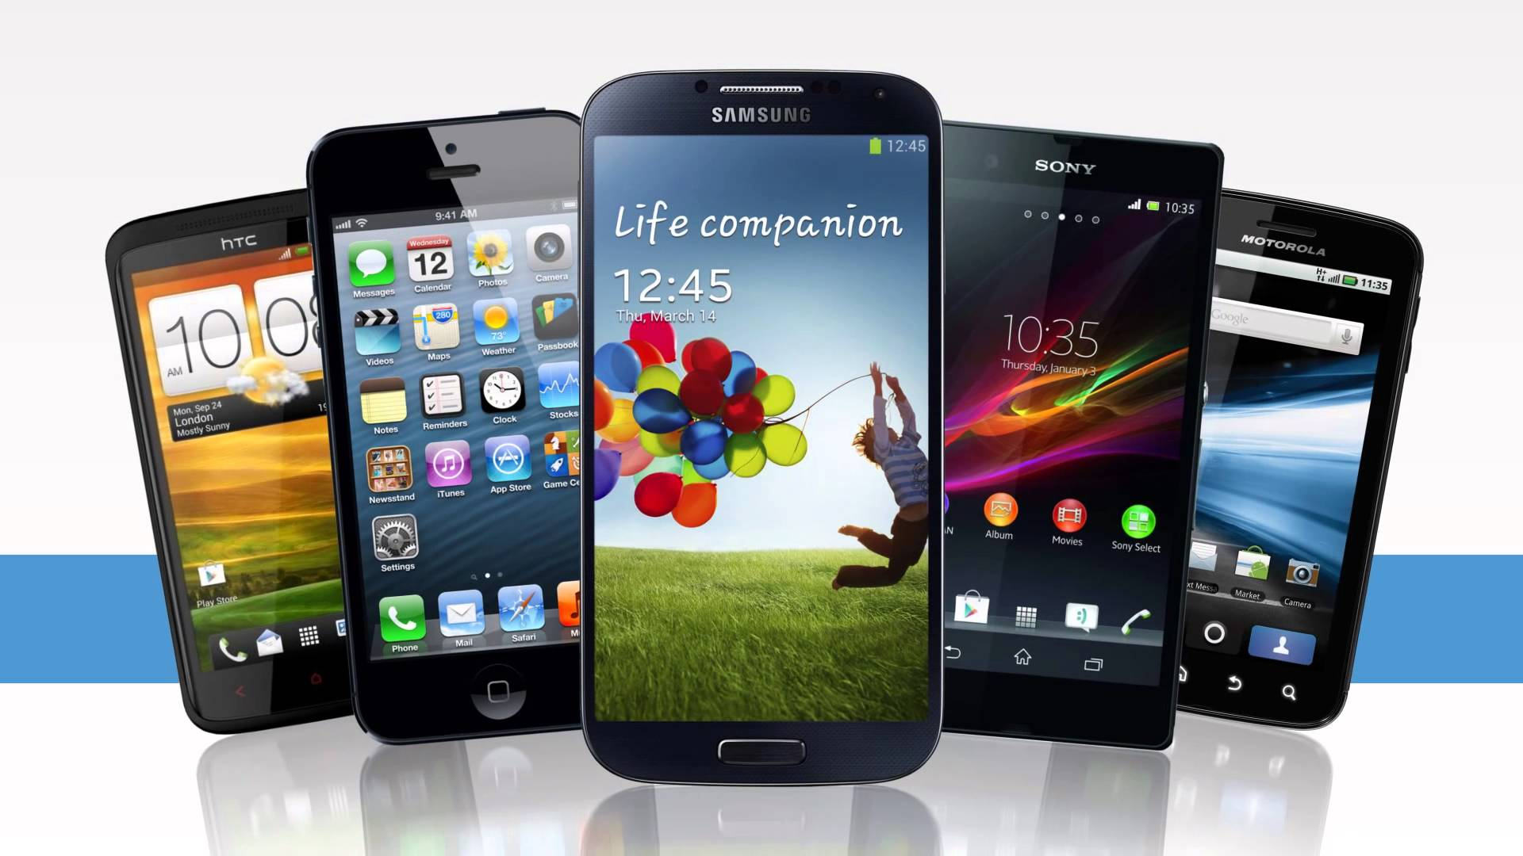
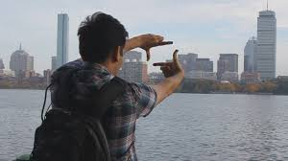
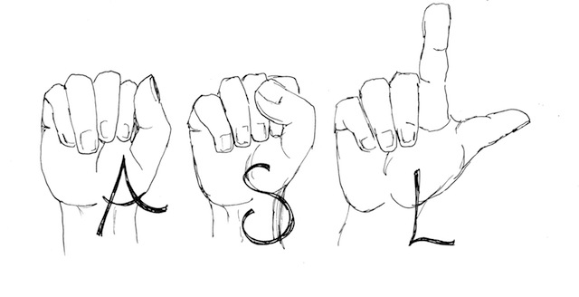
Business Case
Consumer Electronic Devices
Sixth Sense Technology
American Sign Language (ASL)
Image References:
Consumer Electronic Devices: www.youtube.com
Sixth Sense Technology: https://en.wikipedia.org/wiki/SixthSense
American Sign Language: http://asl.uconn.edu/

Slide 3
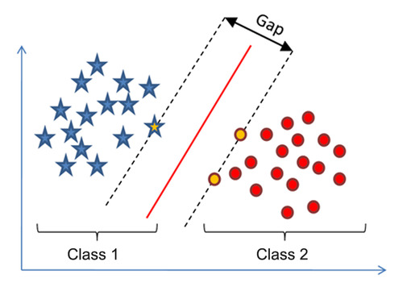
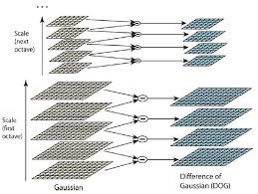
Previous Work
Support Vector Machines (SVM)
Scalar Invariant Feature Transform (SIFT)
And many more …
Support Vector Machines (SVM)
Image References:
Support Vector Machines: http://diggdata.in/post/94066544971/support-vector-machine-without-tears
Scalar Invariant Feature Transform: http://web.eecs.umich.edu/~silvio/teaching/EECS598/lectures/lecture10_1.pdf
Scalar Invariant Feature Transform (SIFT)

Slide 4
Life Cycle
INPUT
SEGMENTATION
HAND DETECTION
HAND TRACKING
APPLICATIONS

Slide 5
Flow Diagram
START
READ THE INPUT VIDEO
DETECT HARRIS CORNERS
PROCESS VIDEO FRAME BY FRAME
OBTAIN CENTROID FOR REGION OF INTERST
HSL ALGORITHM
TRIANGULATE POINTS AND APPLY CONVEX HULL
APPLY MEDIAN FILTERING
STOP
APPLY MORPHOLOGY

Slide 6
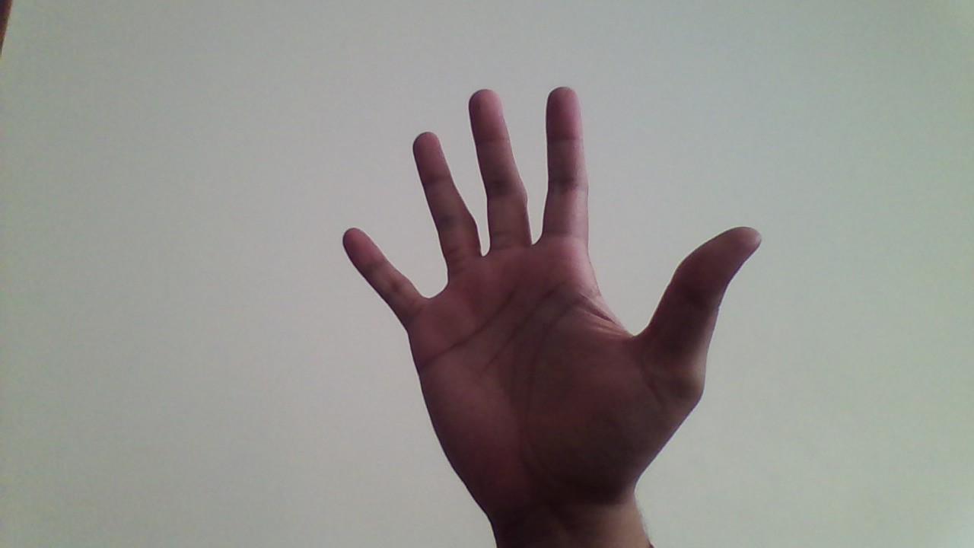
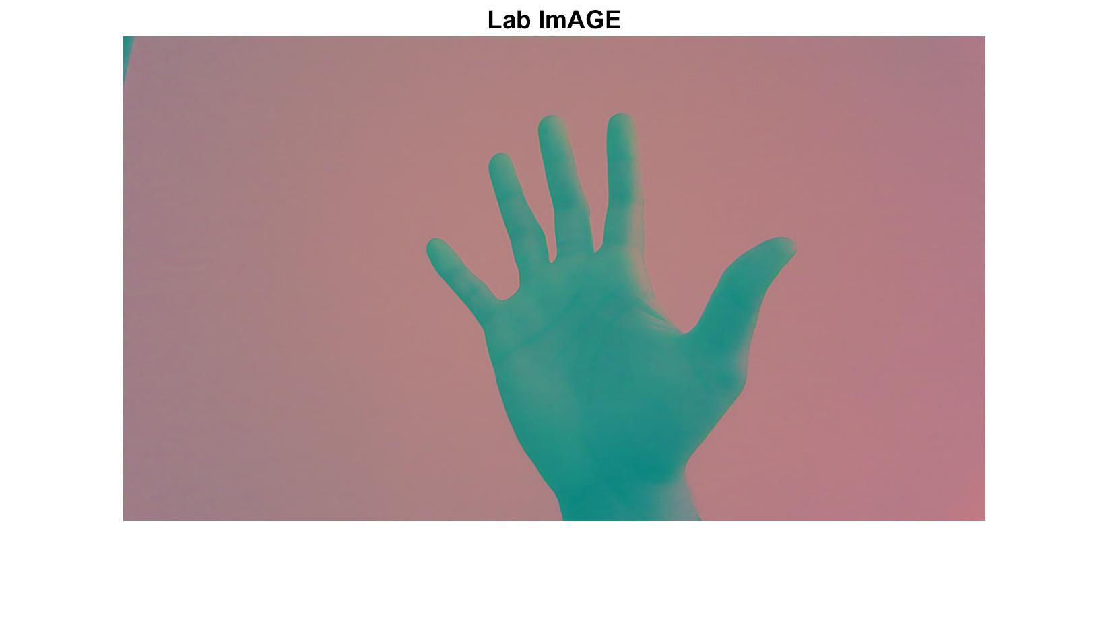
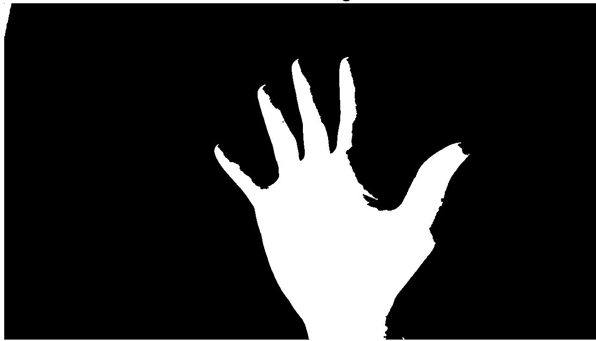
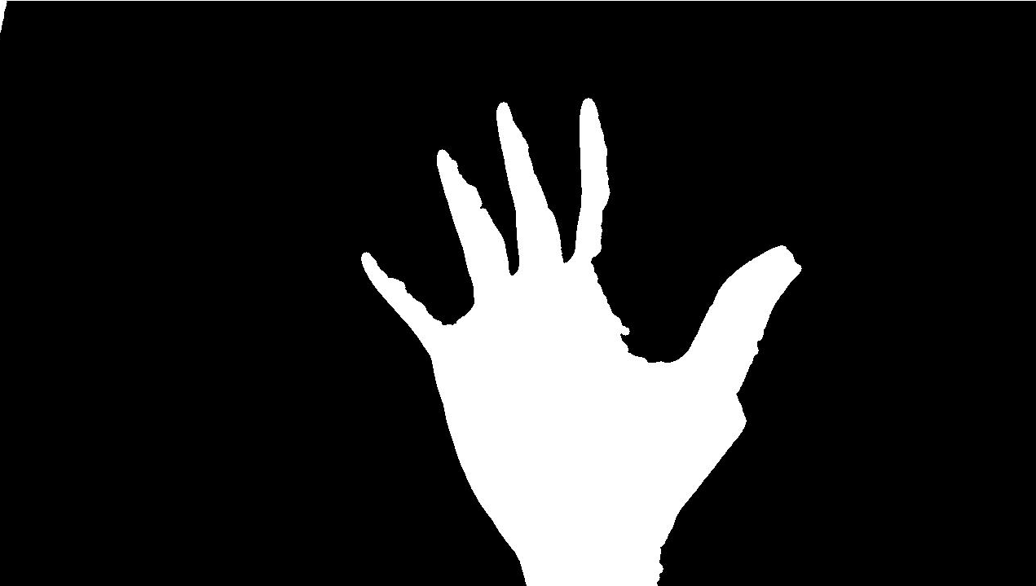

Preprocessing – Hand Segmentation Algorithm
Original Input Image
Image in LAB space
Filtered Image
Binary Image
Opened Binary Image

Slide 7
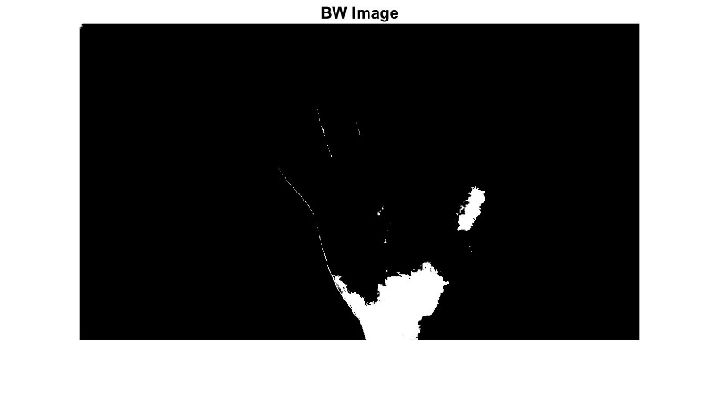

Modification of Otsu’s Method
Traditional Otsu’s Method
Modified Otsu’s Method
Level of gray threshold = 0.4196
Level of gray threshold = 0.4905

Slide 8
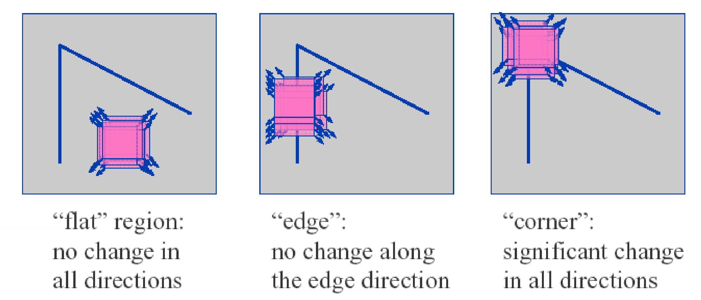
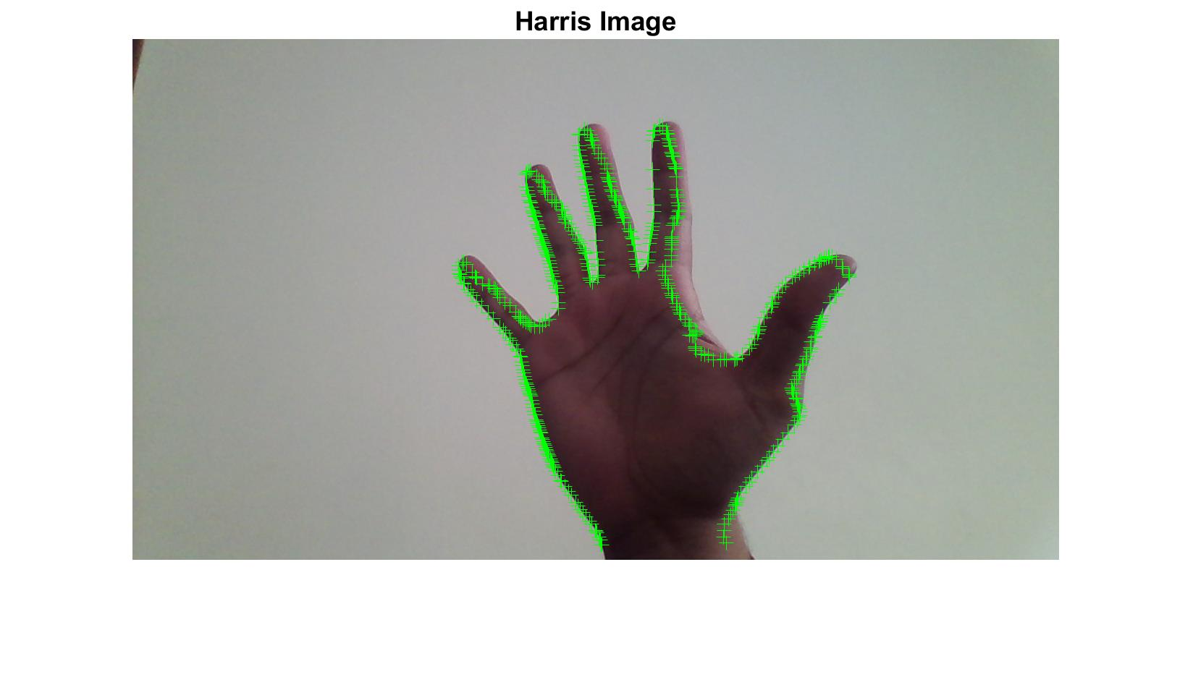
Harris Corners
Plot of Harris corners
Image References:
Harris Corners: http://www.cse.psu.edu/~rtc12/CSE486/lecture06.pdf

Slide 9
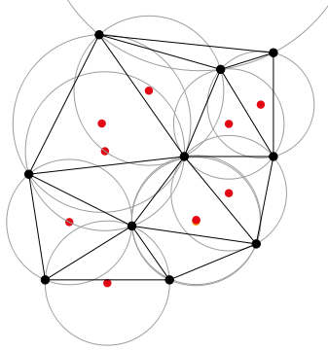
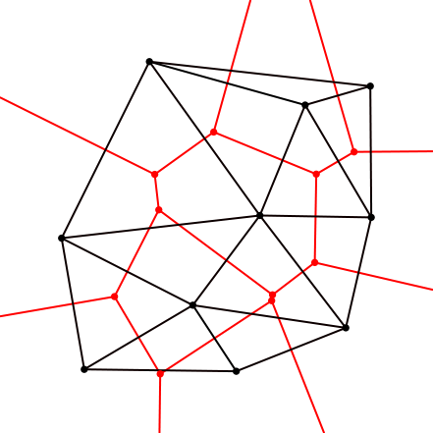
Hand Detection Algorithms
Delaunay Triangulation
Fun Fact!
The Delaunay triangulation with all the circumcircles and their centers (in red).
Connecting the centers of the circumcircles produces the Voronoi diagram (in red).
Image References:
Delaunay Triangulation: https://en.wikipedia.org/wiki/Delaunay_triangulation

Slide 10
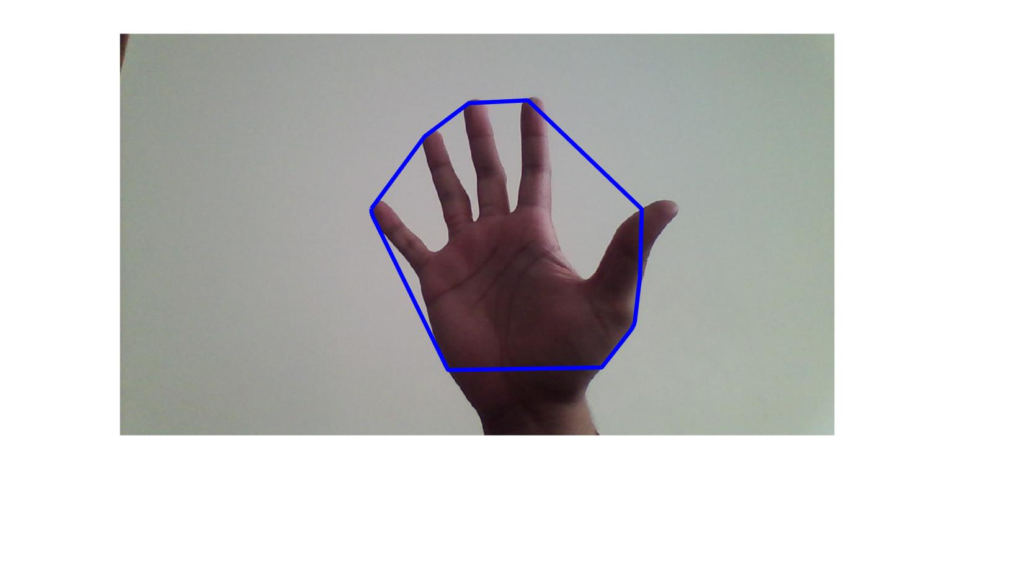
Hand Detection Algorithms
Convex Hull Algorithm
Plot of a Convex Hull

Slide 11
Challenges During Preliminary Design
Illumination
Noise
Motion Blur
Depth of Field
Hardware to Software Configuration Issues
Rotation of Hands

Slide 12
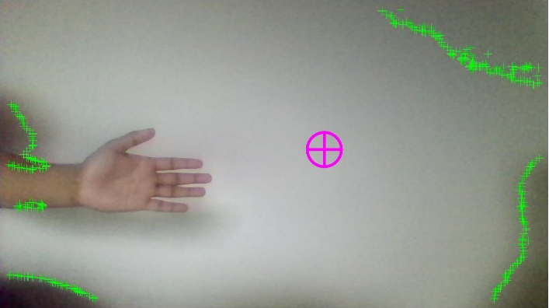
Failure
"It is hard to fail, but it is worse never to have tried to succeed."
-Theodore Roosevelt
Low Illumination & Noise in Background

Slide 13
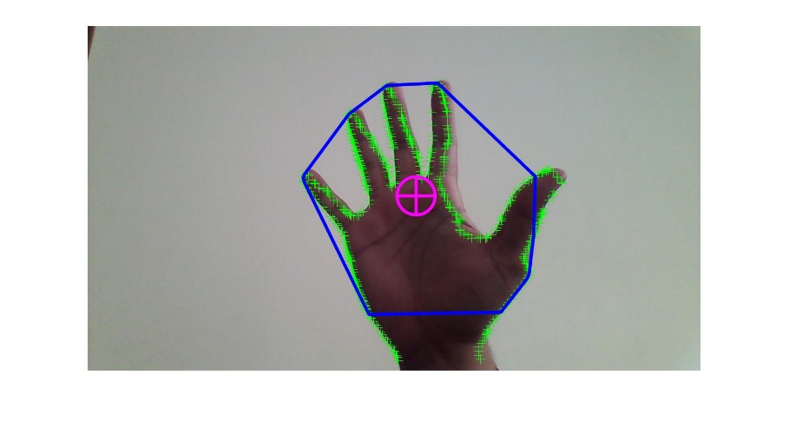
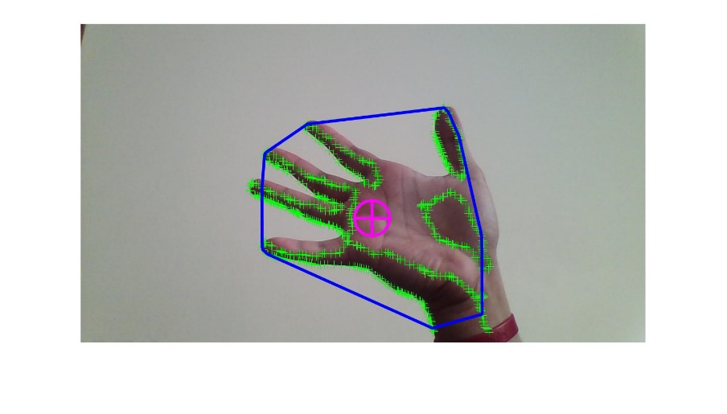
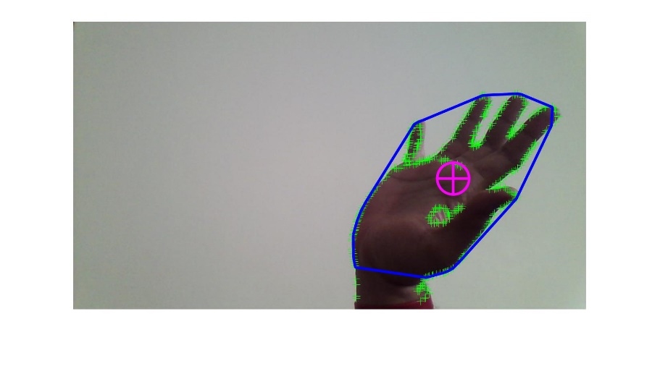
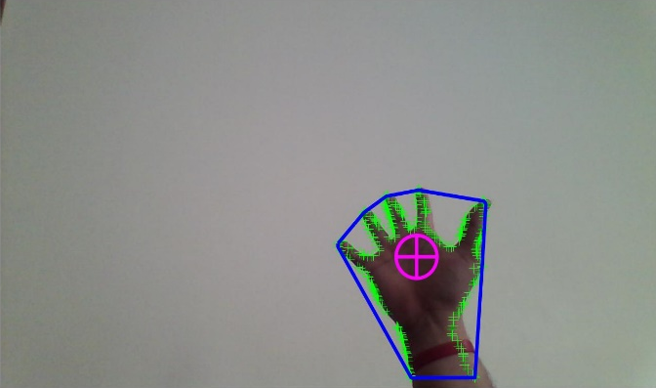
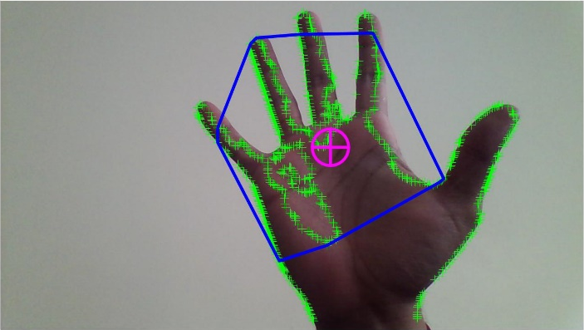
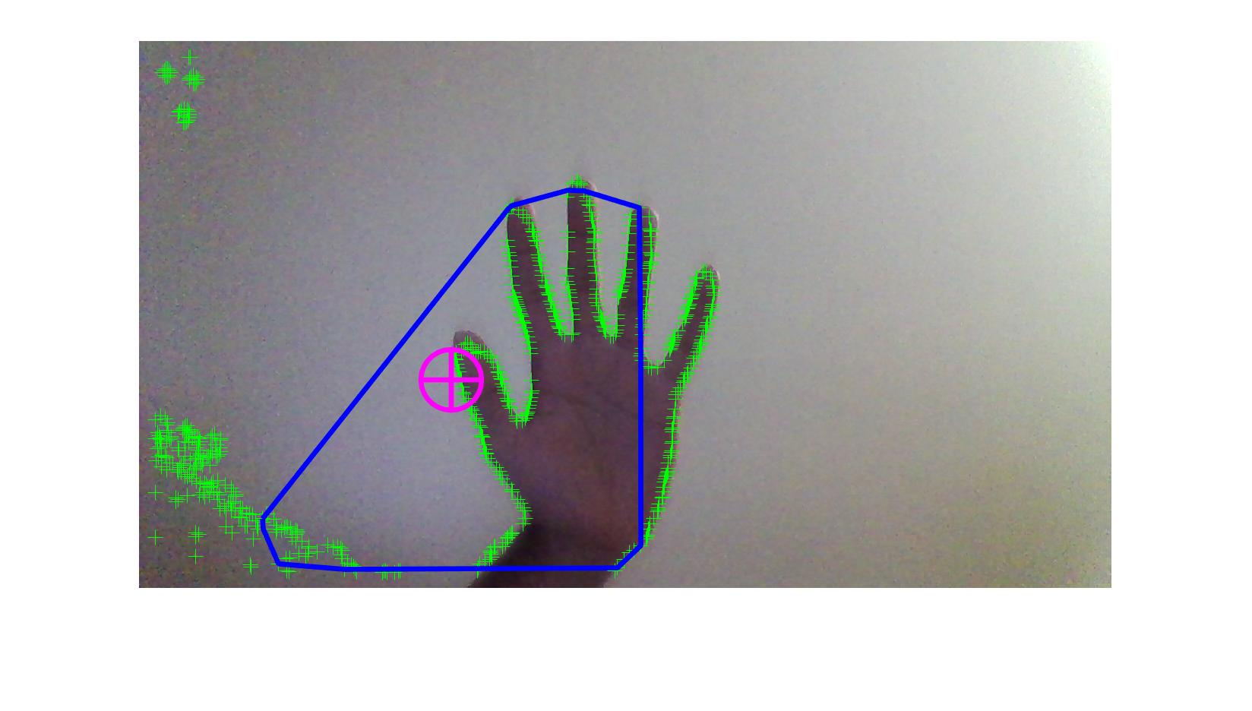
Results
Upright Position
Left Tilted Position
Right Tilted Position
Far Away
Near By
Poor Detection

Slide 14
Future Work
Hand Gesture Recognition
Improve Current Detection Algorithm using Decision Trees ( Fast Rejection Technique)
Sixth Sense Applications

Slide 15
Bibliography
Special Thanks to Swapnil Kamat, Siddharth Tarey, and Niraj Dedhia for providing test cases.
Grateful to Prof. Thomas Kinsman for the motivation and feedback of the project.
Last but not the least… thankful to the MATLAB HELP REPOSITORY and community.

Slide 16
Questions
Thank You!

